Slide 1

Managing Database and SQL performance
30 April 2026
Lynette Barnard

Slide 2

Good database performance starts with good database design
No amount of fine-tuning will make a poorly designed database perform as well as a well-designed database.
Image by DC Studio on Freepik

Slide 3

Database performance tuning
Aim: reduce database system response time
Server side: DBMS performance tuning
DBMS environment configured to respond to client requests in fastest way possible
Optimally using existing resources
Client side: SQL performance tuning
Generate SQL query to return correct answer in least amount of time, using minimum resources at server end
Image by kues1 on Freepik

Slide 4
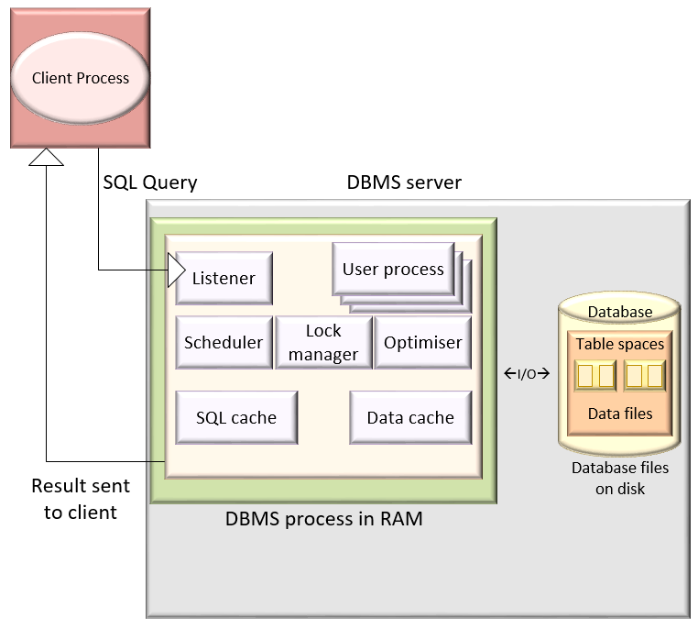
DBMS Architecture
Shared, reserved memory area storing most recently executed SQL statements, procedures, triggers
Represented by processes and structures in memory
I/O requests used to move data from permanent storage to RAM
Data in database stored in data files
Data file groups create table spaces
Data (buffer) cache is reserved memory area for recently accessed data blocks (data read and before data written); also caches indexes
Chapter 13 - Managing DB and SQL Performance

Slide 5
DBMS Architecture
Listens for client requests; hands SQL processing requests to relevant user process
Represented by processes and structures in memory
User process manages each client session; at least one user process per logged-in user
Scheduler responsible for scheduling concurrent execution of SQL requests
Analyses SQL queries; finds most efficient way to access data
Manages all locks placed on data objects

Slide 6



How is a query processed?
Data files
Select...
From...
Where...
Parsing performed by optimiser
Syntax & name check
Check access rights
Decompose / analyse
(fully equivalent, more efficient)
Generate access plan
Store access plan in SQL cache
SQL cache
Access Plan
Data cache
Parsing phase
Execution phase
Fetching phase
Execute I/O operations
Locks for transaction management
Retrieve data blocks
Place data blocks in data cache
Generate result set

Slide 7
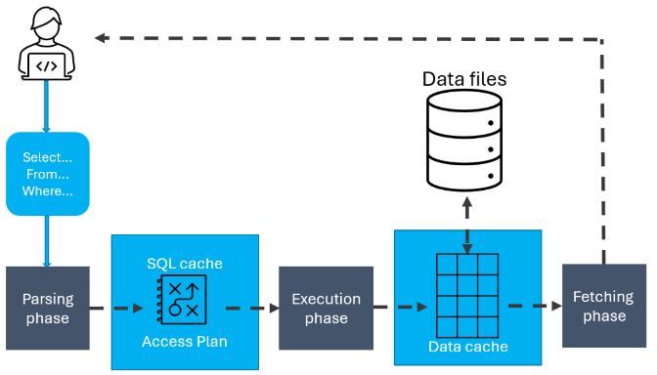
Access plans
Used in parsing phase
Examples of access plan I/O operations
Operation | Description
Table scan (full) | Sequentially reads entire table, from 1st to last row (slowest)
Table access (row ID) | Reads table row directly, using row ID (fastest)
Index scan (range) | Reads index to get row IDs, then accesses table rows directly (faster than full table scan)
Index access (unique) | Used when table has unique index in column
Nested loop | Reads & compares set of values to another set, using nested loop (slow)
Merge | Merges two data sets (slow)
Sort | Sorts data set (slow)

Slide 8
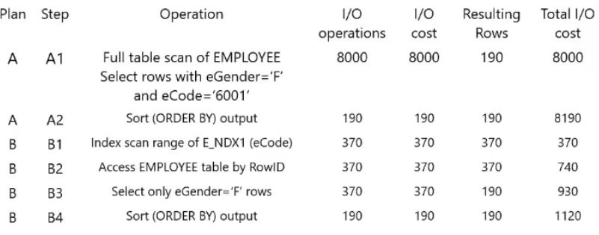
Access plans – See video for example (error – see below)
(should be 1110)
(should be 1300)
Chapter 13 - Managing DB and SQL Performance

Slide 9
Access plan example
Open Access Plan Example from Funda
Work through example

Slide 10
You have access to the following database stats:
Number of products: 375
Number of provinces: 9
Number of vendors: 243
Number of vendors in GAU province: 65
SELECT vCode, vName, vPhone
FROM Vendor
WHERE vProv = “Gau”
ORDER BY vName;
Plan | Step | Operation | I/O Operations | I/O Cost | Resulting Rows | Total I/O Cost
A | A1

Slide 11
You have access to the following database stats:
Number of products: 375
Number of provinces: 9
Number of vendors: 243
Number of vendors in GAU province: 65
SELECT vCode, vName, vPhone
FROM Vendor
WHERE vProv = “Gau”
ORDER BY vName;
Plan | Step | Operation | I/O Operations | I/O Cost | Resulting Rows | Total I/O Cost
A | A1 | Full table scan of VENDOR to select rows with vProv = “Gau” | 243 | 243 | 65 | 243

Slide 12
You have access to the following database stats:
Number of products: 375
Number of provinces: 9
Number of vendors: 243
Number of vendors in GAU province: 65
SELECT vCode, vName, vPhone
FROM Vendor
WHERE vProv = “Gau”
ORDER BY vName;
Plan | Step | Operation | I/O Operations | I/O Cost | Resulting Rows | Total I/O Cost
A | A1 | Full table scan of VENDOR to select rows with vProv = “Gau” | 243 | 243 | 65 | 243
A | A2 | ORDER BY (sort operation) | 65 | 65 | 65 | 308

Slide 13
You have access to the following database stats:
Number of products: 375
Number of provinces: 9
Number of vendors: 243
Number of vendors in GAU province: 65
SELECT vCode, vName, vPhone
FROM Vendor
WHERE vProv = “Gau”
ORDER BY vName;
Plan | Step | Operation | I/O Operations | I/O Cost | Resulting Rows | Total I/O Cost
A | A1 | Full table scan of VENDOR to select rows with vProv = “Gau” | 243 | 243 | 65 | 243
A | A2 | ORDER BY (sort operation) | 65 | 65 | 65 | 308
B | B1 | Index scan range of index created on vProv | 65 | 65 | 65 | 65

Slide 14
You have access to the following database stats:
Number of products: 375
Number of provinces: 9
Number of vendors: 243
Number of vendors in GAU province: 65
SELECT vCode, vName, vPhone
FROM Vendor
WHERE vProv = “Gau”
ORDER BY vName;
Plan | Step | Operation | I/O Operations | I/O Cost | Resulting Rows | Total I/O Cost
A | A1 | Full table scan of VENDOR to select rows with vProv = “Gau” | 243 | 243 | 65 | 243
A | A2 | ORDER BY (sort operation) | 65 | 65 | 65 | 308
B | B1 | Index scan range of index created on vProv | 65 | 65 | 65 | 65
B | B2 | Table access by rowID of B1 | 65 | 65 | 65 | 130

Slide 15
You have access to the following database stats:
Number of products: 375
Number of provinces: 9
Number of vendors: 243
Number of vendors in GAU province: 65
SELECT vCode, vName, vPhone
FROM Vendor
WHERE vProv = “Gau”
ORDER BY vName;
Plan | Step | Operation | I/O Operations | I/O Cost | Resulting Rows | Total I/O Cost
A | A1 | Full table scan of VENDOR to select rows with vProv = “Gau” | 243 | 243 | 65 | 243
A | A2 | ORDER BY (sort operation) | 65 | 65 | 65 | 308
B | B1 | Index scan range of index created on vProv | 65 | 65 | 65 | 65
B | B2 | Table access by rowID of B1 | 65 | 65 | 65 | 130
B | B3 | ORDER BY (sort operation) | 65 | 65 | 65 | 195

Slide 16
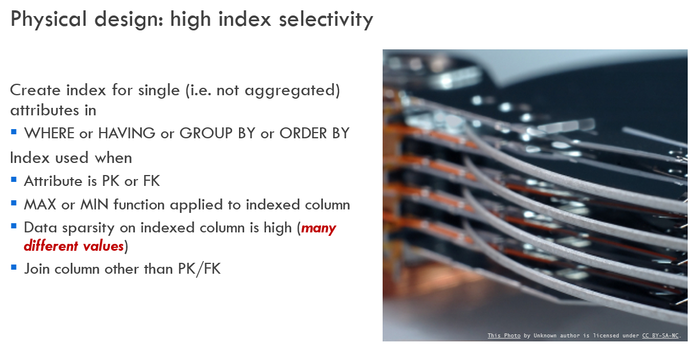
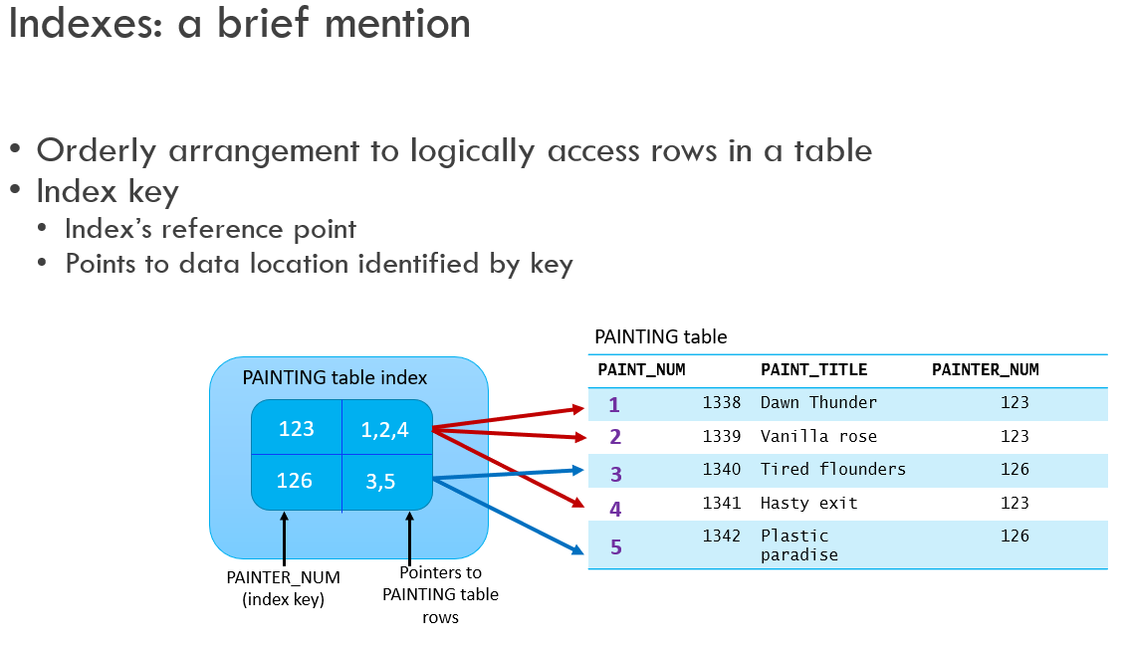
INDEX – What? Why? (re-cap)
Ch 2-4 Models and Relational alg
Ch 10 and 11 Database Design

Slide 17
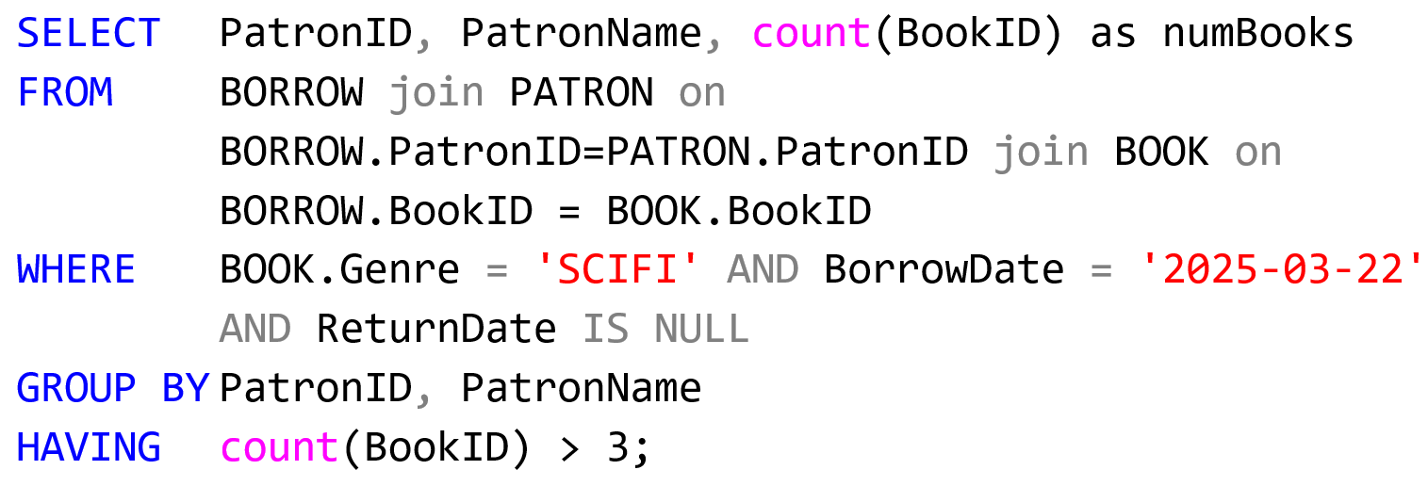
WHEN to use an index
For single attribute in WHERE, GROUP BY, HAVING, ORDER BY clause
Columns with high data sparsity (many different values)
When MIN or MAX function is applied to indexed column
PK, FK, join columns other than PK/FK

Slide 18
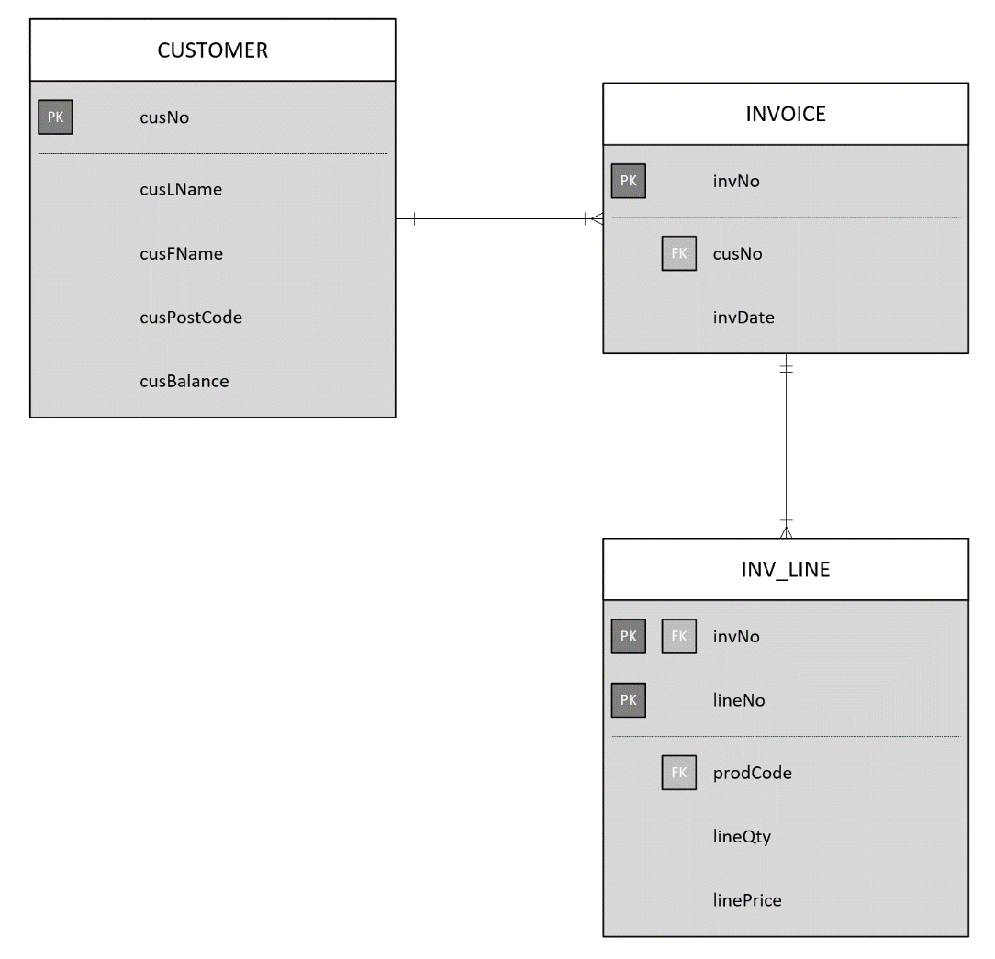
Are there any existing index(es)?
SELECT cusNo, MAX(lineQty*linePrice) as lineTotal
FROM CUSTOMER inner join INVOICE on customer.cusNo = invoice.cusNo inner join INV_LINE on invoice.invNo = inv_line.invNo
WHERE cusPostCode = ‘6025’
GROUP BY cusNo;
Should you create another index?

Slide 19
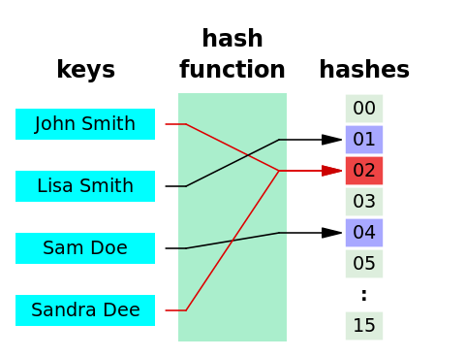
Indexes and query optimisation
This Photo by Unknown author is licensed under CC BY-SA.
Most DBMSs implement indexes using data structures
Hash index
Use hash algorithm to create hash value from key column
Value points to hash table entry; which points to actual data row location
Mostly used in equality conditions (e.g. checking for first name, surname)
B-tree index
Self-balanced tree; default (most commonly used) in databases
Popular when column values repeat small number of times (lots of unique values)
Bitmap index
Uses a bit array (0s and 1s), representing existence of a value or condition
Mostly used in data warehouses where small number of values repeated often

Slide 20
SQL performance
Conditional expressions
Conditional expressions normally within WHERE or HAVING clauses
Restricts output to rows (or groups of rows) matching conditional criteria
Common practice for efficient SQL
Use simple columns or literals in conditions
Numeric comparison faster than character, date, NULL
Equality faster than inequality
Transform conditional expressions to use literals
Write equality condition first
AND: use most likely false conditions first
OR: use most likely true condition first
Avoid NOT
Also get rid of all old-style joins

Slide 21
SQL performance / optimisation resources & Activity
https://www.datacamp.com/blog/sql-query-optimization
https://blog.devart.com/how-to-optimize-sql-query.html
https://www.sqlshack.com/query-optimization-techniques-in-sql-server-the-basics/
https://blog.quest.com/sql-query-optimization-how-to-determine-when-and-if-its-needed/
Complete Optimising Query Activity
Use assignment format, in groups of max 3 (no individual submissions)
Due: Friday, 1 May @ 09:00 (I know it’s a public holiday…)

Slide 22

Semester test 2 – third notice
Schedule:
Tuesday, 12 May
May bring in ONE page (double sided) hand written (no photocopies) notes
2-hour test, 60 marks
Book a timeslot on Funda by no later than Monday, 4 May
15:45 – 17:45
OR
17:30 – 19:30 (very limited seating)

